Slide 1
Sentiment Analysis Using Gated Recurrent Unit
Presented By: Supervisor:
Sagar Timalsena Assistant Professor Bikash Balami
Notes:
Good afternoon sir, and I’d like to thank Assistant Professor Bikash Balami, the Head of Department asst. prof Sarbin Sir, respected Sir Nabaraj and all faculty members for their support as I present on ‘Sentiment Analysis Using Gated Recurrent Unit (GRU).

Slide 2
Overview
Introduction
Problem Statement
Objective
Literature Review
Methodology
Results and finding
Conclusion and further recommendations
Notes:
Today’s presentation will cover the following:
Introduction: What sentiment analysis is and its significance.
Problem Statement: Challenges in current sentiment analysis methods.
Objective: Goals of using Gated Recurrent Units (GRUs) in sentiment analysis.
Methodology: How GRUs are applied to improve sentiment analysis.
Results and Findings: Key outcomes and insights from using GRUs.
Conclusion: Summary of findings and future directions.
Literature Review (LR) - Provide an overview of relevant research and theories that support your work.
References - List all sources and studies cited in your presentation.

Slide 3
Introduction
Sentiment analysis (opinion mining) involves analyzing emotions and opinions in text.
Gated recurrent units (GRUs) are a type of RNN architecture.
GRUs are popular for sentiment analysis due to their simplicity and effectiveness.
Businesses, governments, and organizations use sentiment analysis to understand public opinion.
Notes:
GRU is supervised learning.
In sentiment analysis, a GRU model would be trained on a dataset where each piece of text (input) is paired with a sentiment label (output) indicating whether the sentiment is positive, negative, or neutral. The model learns to map inputs to outputs based on this labeled data.

Slide 4
Problem Statement
Handle large amounts of text
Hard to accurately understand sentiments
Leading to less accurate results
Notes:
Talk About old RNN

Slide 5
Objective
To implement a GRU-based sentiment analysis model
To evaluate the performance of the model using appropriate metrics
To integrate necessary pre-processing steps to clean and prepare text data for model training.
Notes:
Performance Measure are: accuracy, precision, recall, f1 score
Pre-Processing Steps:
1. Lowercasing 2. removing stop words 3. Tokenization 4. Removing Special Characters 5. remove number 6.remove extra space 7. Stemming/Lemmatization

Slide 6
Literature Review
Sentiment analysis[1] is a crucial tool for understanding public sentiment about various topics. This study examined different methods for text sentiment analysis, including dictionary-based and machine-learning techniques, focusing on adapting these methods for Twitter data.
This adaptation[2] posed several challenges due to the unique nature of Twitter's text data, such as brevity and informal language.
This study compared various deep learning models for sentiment analysis, specifically[3] three models based on convolutional neural networks (CNNs) and five based on recurrent neural networks (RNNs).
Fine-tuning[4] parameters like dropout rates, layer numbers, and activation functions can significantly enhance model performance, making GRUs reliable for applications requiring precise predictions.

Slide 7
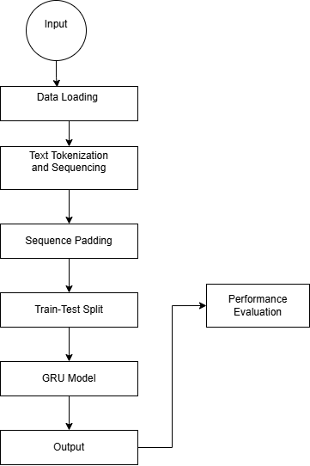
Methodology
Figure: System Flowchart
Notes:
Pre-Processing Steps:
1. Lowercasing 2. removing stop words 3. Tokenization 4. Removing Special Characters 5. remove number 6.remove extra space 7. Stemming/Lemmatization

Slide 8
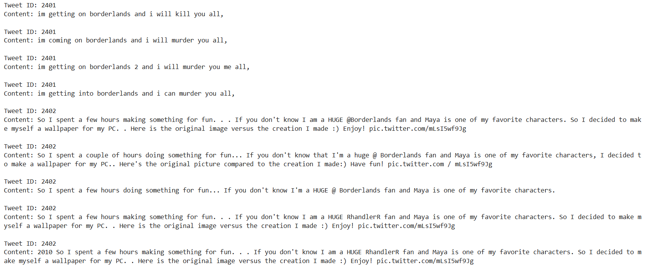
Dataset Sample

Slide 9
Implementation
The program is developed using Python (version 3.12.4) as the primary programming language within the VS Code Integrated Development Environment (IDE), Kaggle notebook .
Libraries Used:
NumPy
Pandas
Matplotlib
Seaborn
TensorFlow and Keras
Scikit-learn

Slide 10
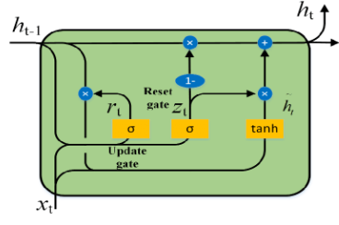
Implementation details
GRU Architecture
Notes:
Gru is a type of RNN.
It is introduced to overcome the limitations of traditional RNN
1. Update gate and reset gate
LSTM contains 3 gate
1. Input , Forget and output
Complex mathematical operations

Slide 11

GRU works in the following ways
Hidden State
It Capture information about the sequence of input.
2. Update Gate
Notes:
Update gate:
Gru compute update gate and determines how much previous hidden states to retain and how much new information to incorporate from current input. And computed by using sigmoid activation function.

Slide 12


Continue..
3. Reset Gate
4. Candidate Hidden State
Notes:
Reset Gate:
it is computed at each time step to control how much of the previous hidden state should be forgotten.
It controls How much of the previous state is include in the new candidate
Candidate Hidden State:
. It represents the new candidate content that will be added to the current state.

Slide 13
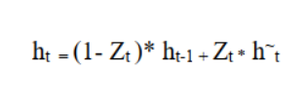
Cont…
5. Update Hidden State
Notes:
It is the combination of previous hidden state and the new candidate activation , controlled by the update gate.

Slide 14
Applications of GRUs
Natural Language Processing (NLP): Sentiment analysis, machine translation, and text generation.
Speech Recognition: Converting spoken language into text.

Slide 15
Advantages of GRUs:
Handles Long-Term Dependencies
Effective and Simple
Good for Sequential Data
Avoids Vanishing Gradient Problem
Notes:
Handles Long-Term Dependencies:
GRUs can remember important information for a long time, making them good at understanding context in sequences.
Effective and Simple:
GRUs are easier to implement and often perform just as well or better than more complex models.
Good for Sequential Data:
They work well with data that has a sequence, like sentences in a text, making them great for language tasks and time series data.
Avoids Vanishing Gradient Problem:
GRUs are designed to avoid a common issue in RNNs where the model stops learning effectively over long sequences.

Slide 16
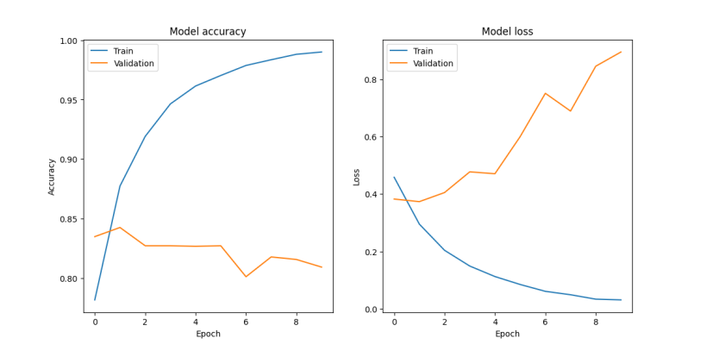
Result analysis 1. Training and Validation Loss and accuracy plots
Notes:
Left Plot
Training Accuracy (Blue Line):
Increases steadily and reaches near 1.0, indicating the model is fitting the training data very well.
Validation Accuracy (Orange Line):
Starts high but fluctuates and decreases slightly over epochs, indicating potential overfitting.
Right Plot
Training Loss (Blue Line):
Decreases consistently, showing the model is learning from the training data and minimizing error.
Validation Loss (Orange Line):
Initially decreases but then increases, further indicating overfitting as the model performs worse on unseen data over time.

Slide 17
2. Model Performance Measure
Accuracy | Precision | Recall | F1 Score
82.61% | 80.84% | 85.53% | 79.66%

Slide 18
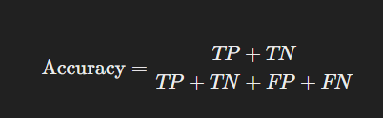



Notes:
True Positive (TP): The model correctly predicts the positive class.
True Negative (TN): The model correctly predicts the negative class.
False Positive (FP): The model incorrectly predicts the positive class.
False Negative (FN): The model incorrectly predicts the negative class

Slide 19
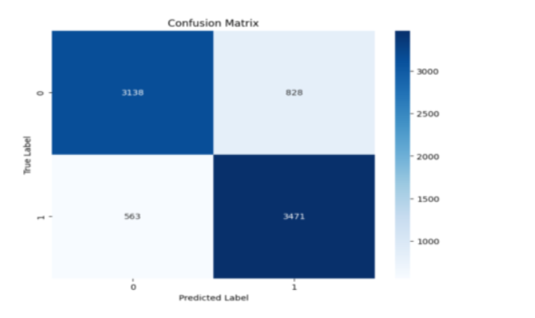
3. Confusion Matrix
Notes:
3471 true positive
3138 are true negative
563 are false Negative
828 are false Positive
1st row True Negative | False Positive
2nd row False Positive | True Positive

Slide 20
Conclusion and Future Recommendations
GRU model accurately analyzes US airline review tweets.
Achieves 82.61% accuracy, 80.84% precision, 85.53% recall, and 79.66% F1 score.
Adjust GRU units and learning rates to find the optimal configuration.
Expand training data using augmentation techniques.
Notes:
Top 2 point conclusion and remaining is further recommendations

Slide 21
References
[1] A. D. T. and J. A., “Multimodal Sentimental Analysis Using Hierarchical Fusion Technique,” in 2023 IEEE 4th Annual Flagship India Council International Subsections Conference(INDISCON), 2023, pp. 1–8. doi: 10.1109/INDISCON58499.2023.10270094.
[2] K. S. Jones, “Natural language processing: a historical review,” Curr. issues Comput. Linguist. honour Don Walk., pp. 3–16, 1994.
[3] P. Acharya and B. K. Bal, A Comparative Study of SMT and NMT: Case Study of English-Nepali Language Pair. 2018. doi: 10.21437/SLTU.2018-19.
[4] B. Krishnamurthy, S. Senthilkumar, A. Singh, and P. Sharma, Sentiment Analysis with NLP on Twitter Data. 2022. doi: 10.1109/SMARTGENCON56628.2022.10084036.
[5] K. Sharma, D. Jain, A. Jain, Y. S. Rathore, and S. Agarwal, “Sentimental Analysis based on Machine Learning Technique,” in 2024 3rd International Conference for Innovation in Technology (INOCON), 2024, pp. 1–7. doi: 10.1109/INOCON60754.2024.10511973.
[6] A. M. Turing, Computing machinery and intelligence. Springer, 2009.

Slide 22

Thank You

Slide 23
Why GRU IS used to do sentiment analysis ?
Sequential Data Handling
Vanishing Gradient Problem
Context Preservation
Computational Efficiency

Slide 24
